Slide 1
Lecture 2
Topics: Review of Programming I, Part II
Chapters 6 - 7

Slide 2
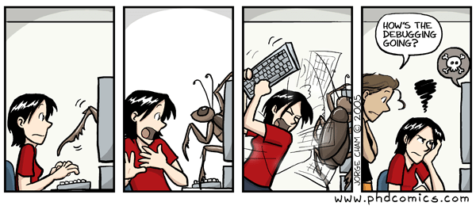
Testing and Debugging
During and after writing a program, you should test it to see whether it performs correctly.
Bug: A mistake in a program.
Debugging: The process of finding, correcting and eliminating the mistakes.

Slide 3
Common Errors/Bugs
Syntax Error: A grammatical mistake in your program. You have to be VERY strict about following the rules for the language you are using.
Run-time Error: An error that is detected when your program runs.
Logic Error: You wrote the right syntax, but the program is not showing the correct output.

Slide 4
Find the Syntax Error!
public class SyntaxErrors
{ public static main(String args[])
{
System.out.println("Hello, I have syntax errors!")
} }
Invalid method type declaration.
Need a return type.
Missing semi-colon.

Slide 5
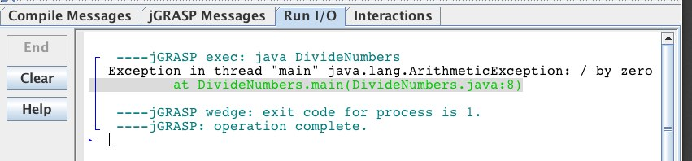
Find the Run-time Error!
public class DivideNumbers
{ public static void main(String args[])
{ int den = 0; int num = 5; System.out.println(num + " divided by " + den + " is " + num/den); } }
Throws a run-time exception
Prints out a stack trace

Slide 6
Find the Logic Error!
import java.util.Scanner; public class Area
{ public static void main(String [] args)
{ Scanner kb = new Scanner(System.in); System.out.println("Enter the radius in inches: ");
double radius = kb.nextDouble(); double area = 3.1415926 * radius + radius; System.out.println("The area is: " + area); } }
Area = πr²

Slide 7
Arrays
You have to specify what kind of things the array is going to hold (i.e. the data type!).
The bracket indicates that you are making an array object.
This second style of declaring an array comes from the C language and was adopted in Java to accommodate C programmers.
int[] arrayName;
int arrayName[];

Slide 8
Array declarations: Examples
int[] numbers;
String[] stringArray;
double[] decimalNumbers;
boolean[] truesAndFalses;

Slide 9
Creating arrays: Examples
int[] arrayName = new int[10];
int[] arrayNameTwo;
arrayNameTwo = new int[20];

Slide 10
Example
A specific element in an array is accessed by its index.
In Java, array indices always start with 0.
You can access the length of an array using the length instance variable of the array class (numbers.length).
double[] numbers = new double[4]; numbers[0] = 35.2;
numbers[1] = 17.3;
numbers[2] = 8.3;
numbers[3] = 12.9;
int arrayLength = numbers.length;
Assignment

Slide 11
Short-hand Initialization
Java has a shorthand notation, known as the array initializer, which combines the declaration, creation, and initialization of an array in one statement.
dataType[] arrayName = {val1, val2, val3, .., valn};
double[] numbers = {10.2, 13.4, 7.8, 9.2, 1.6};

Slide 12
Printing elements in arrays
char[] grades = {'A', 'B', 'C', 'D', 'F'};
for (int i = 0; i < grades.length; i++)
{
System.out.println(grades[i]);
}

Slide 13
Example
Write a JAVA program which will prompt the user to enter a positive integer n (greater than 1), and then prompts the user to enter n integers. The program outputs "ascending" if the numbers entered are in increasing order, "descending" if the numbers are in decreasing order, and "neither" otherwise. Finally, after ascending, descending, or other has been displayed, the program will then print the numbers in reverse order. Below are three sample runs:
Things to think about:
How should the input be saved? What data type?
How do you read in the input?
What are the differences between each of the outputs?
What code structure should be used for determining whether something is ascending, descending or neither?
Enter n: 5
Enter 5 integers: -2 5 7 8 30
Ascending: 30 8 7 5 -2
Enter n: 3
Enter 3 integers: 7 3 2
Descending: 2 3 7
Enter n: 4
Enter 4 integers: 7 -4 8 0
Neither: 0 8 -4 7

Slide 14
Scanner kb = new Scanner(System.in);
System.out.print("Enter n: ");
int n = kb.nextInt();
int[] array = new int[n];
System.out.print("Enter " + n + " integers: ");
for (int i = 0; i < n; i++)
{
array[i] = kb.nextInt();
}
boolean ascending = true;
int j = 0;
while (ascending && j < n - 1)
{
if (array[j] > array[j + 1])
ascending = false;
j++;
}
...
boolean descending = true;
int k = 0;
while (descending && k < n - 1)
{
if (array[k] < array[k + 1])
descending = false;
k++;
}
if (ascending)
System.out.print("Ascending: ");
else if (descending)
System.out.print("Descending: ");
else
System.out.print("Neither: ");
for (int i = n – 1; i >= 0; i--)
{
System.out.print(array[i] + " ");
}

Slide 15

Methods
class HelloWorld
{
public static void main(String[] args)
{
System.out.println("Hello World!");
}
}
How many methods are there?

Slide 16
Defining Methods
A method is a collection of statements that are grouped together to perform an operation.
Methods can be used to define reusable code and organize and simplify coding.
A method definition consists of its method name, parameters, return value type and body.
Each method has its own name. When that name is encountered in a program, the execution of the program branches to the body of that method.
When the method is finished, execution returns to the area of the program code from which it was called, and the program continues on to the next line of code.

Slide 18
Example
public class TestMax
{
public static void main(String[] args)
{
int i = 5;
int j = 2;
int k = max(i, j);
S.O.P.L("The max of " + i + " and " + j + " is " + k);
}
public static int max(int n1, int n2)
{
int result;
if (n1 > n2)
result = n1;
else
result = n2;
return result;
}
}
Memory: main
i: 5
j: 2
k: max(i, j)
max(5, 2)
5
Memory: max(5, 2)
n1: 5
n2: 2
result:
5
Output
The max of 5 and 2 is 5
Each method has its own copy of the variables in memory. Each method has its own separate memory box.

Slide 19
Example
public class TestPassByValue
{
public static void main(String[] args)
{
int n1 = 1;
int n2 = 2;
S.O.P.L("n1 is " + n1 + " and n2 is " + n2);
swap(n1, n2);
S.O.P.L("n1 is " + n1 + " and n2 is " + n2);
}
public static void swap(int num1, int num2)
{
int temp = num1;
num1 = num2;
num2 = temp;
S.O.P.L("num1 is " + num1 + " and num2 is " + num2);
}
}
Memory: main
n1: 1
n2: 2
swap(n1, n2)
swap(1, 2)
Memory: swap(1, 2)
num1: 1
num2: 2
temp: 1
2
1
Output
n1 is 1 and n2 is 2
num1 is 2 and num2 is 1
n1 is 1 and n2 is 2
Notes:
Note: Every time a method is invoked or called, a new memory box is created on the stack.
If swap(3,4) was called, it would get its own memory box.

Slide 20
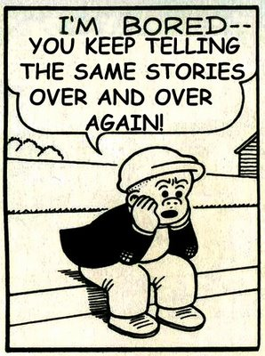
Example
Find the sum of integers from 1 to 10, from 20 to 30, and from 35 to 45, respectively.
public static void main(String[] args)
{
sum = 0;
for (int i = 1; i <= 10; i++)
sum += i;
S.O.P.L("Sum from 1 to 10 is " + sum);
sum = 0;
for (int i = 20; i <= 30; i++)
sum += i;
S.O.P.L("Sum from 20 to 30 is " + sum);
sum = 0;
for (int i = 35; i <= 45; i++)
sum += i;
S.O.P.L("Sum from 35 to 45 is " + sum);
}
What do you notice about this code?

Slide 21
Example: Using methods
Find the sum of integers from 1 to 10, from 20 to 30, and from 35 to 45, respectively.
public static void main(String[] args)
{
sum(1, 10);
sum(20, 30);
sum(35, 45);
}
public static void sum(int n1, int n2)
{
int sumNums = 0;
for (int i = n1; i <= n2; i++)
sumNums += i;
S.O.P.L("Sum from " + n1 + " to " + n2 + " is " + sumNums);
}

Slide 22


Methods
Remember the rule?
When arrays are passed to methods,
this is like inviting your friend that’s
always on their iPhone...

Slide 23

Methods and Arrays: The Big Difference
The method header is very similar:
The invocation (calling) is very similar
public static void arrayMethod(int[] array)
{
// Stuff inside the method
}
public static void main(String[] args)
{
int[] numArray = {1, 2, 3};
arrayMethod(numArray);
}
The big difference between passing arrays and primitive data types:
When you pass an argument that’s a primitive type, the value is passed.
When you pass an array, the whole reference to the array object is passed, which means that if you change it, then you change it everywhere else that it is being used - even if your method doesn’t return anything!!

Slide 24
Returning an array from a method
public static void main(String[] args)
{
int[] numArray= {1, 2, 3};
int[] reverseArray = reverse(numArray);
}
public static int[] reverse(int[] array)
{
int[] revArray = new int[array.length];
for (int i = 0; i < array.length; i++)
{
revArray[i] = array[array.length - 1 - i];
}
return revArray;
}

Slide 25
Overloading Methods
Overloading is a fancy name for having methods with the same name but different formal parameters.
Overloading lets you make multiple versions of a method, with different parameter lists, for convenience.
The return types of the methods can be different (they don’t have to be).
If you change only the return type, that’s not overloading! You MUST change the parameter types or order.

Slide 26
An example of overloading
Different parameter types
public int addNumbers(int first, int second)
{ return first + second; } public double addNumbers(double first, double second)
{ return first + second; }
Different return types

Slide 27
An example of overloading
Different parameter types
private String uniqueId;
public void setUniqueID(String SSN)
{ uniqueID = SSN; } public void setUniqueID(int SSN)
{ uniqueID = Integer.toString(SSN);
}
Same return types

Slide 28
Be the compiler: Are the overloaded methods are legal?
public boolean frighten(int numTeeth)
{ System.out.println("aarrgh " + numTeeth);
return true; } public int frighten(int sharpTeeth)
{ System.out.println("a bite?");
return sharpTeeth; }
You need to change the parameter types.

Slide 29
Be the compiler: Are the overloaded methods are legal?
✔
public boolean frighten(String grunt)
{ System.out.println("aarrgh " + grunt);
return true; } public int frighten(int sharpTeeth)
{ System.out.println("a bite?");
return sharpTeeth; }

Slide 30

That’s all for today!
Homework #1 will be posted on the course website.
Due: Thursday, 01/21/16 by 9:00 a.m.

